Slide 1
COLLEGE DEPARTMENT MANAGEMENT
R.SUHITHA 24KB1A05FY
R.ASRITHA 24KB1A05FR
V.NISCHITHA 24KB1A05MX
S.BAVANI 24KB1A05GJ

Slide 2
Introduction:
The project models a college department management system using basic data structures in C.
Departments (like CSE, ECE, MECH) are stored in a fixed-size array.
Each department contains a linked list of its faculty members.
It showcases the use of structs in C for organizing complex data.

Slide 3
OBJECTIVE:
To implement department storage using arrays for efficient indexing.
To use linked lists for dynamic handling of faculty members in each department.
To improve data organization and retrieval within an academic system.
To provide a foundational example of combining static and dynamic structures in C programming.

Slide 4
System Overview:
Each department in the array maintains a singly linked list of faculty members.
Faculty members can be added dynamically to any department.
The system supports traversing each department to display its faculty list.
It demonstrates the integration of static (array) and dynamic (linked list) data structures.

Slide 5
Data Structures Used:
Array of Departments:
Fixed-size array to store predefined departments (e.g., CSE, ECE, MECH).
Allows direct indexing for quick access to each department.
Singly Linked List for Faculty Members:
Singly Linked List for Faculty Members
Each department points to a linked list of faculty nodes.
Allows dynamic memory allocation, enabling flexible addition of faculty

Slide 6
Department Representation:
Departments are represented using a fixed-size array of structures.
Each array element corresponds to a single department (e.g., CSE, ECE, MECH).
The structure for a department contains:
A name field (e.g., "CSE") to identify the department.
A pointer to the head of a linked list that stores its faculty members.
Example:
typedef struct {
char name[10];
Faculty* head;
} Department;

Slide 7
Faculty Management:
Each department manages its faculty members using a singly linked list.
Faculty members are represented as nodes, each containing:
Faculty name
Pointer to the next faculty member
Allows dynamic addition of faculty members without size limitations.
Insertion is done at the beginning of the linked list for simplicity and speed.
Traversal is used to display all faculty under a specific department.

Slide 8
Insertion Operation:
Purpose: Add a new faculty member to a specific department.
Steps Involved:
Create a new faculty node dynamically using malloc.
Assign the faculty name to the node.
Point the new node’s next to the current head of the department's faculty list.
Update the department’s head pointer to the new node.

Slide 9
Traversal Operation:
Purpose: To display all faculty members in each department.
Steps Involved:
Loop through the array of departments.
For each department, get the head pointer of its faculty linked list.
Traverse the linked list using a temporary pointer.
Print or display each faculty member’s name.

Slide 10
Coding:
https://onlinegdb.com/mPTSl57bkK

Slide 11
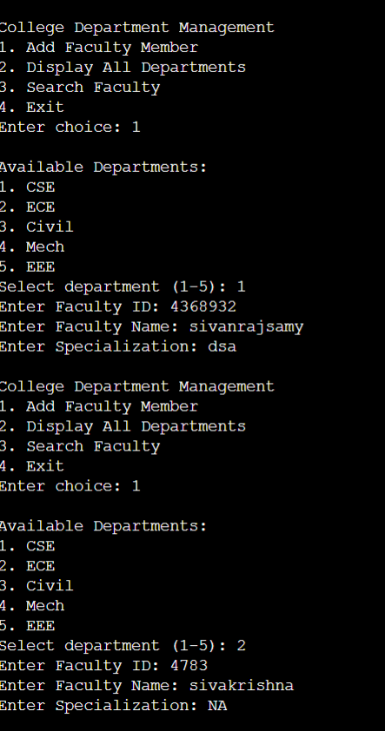
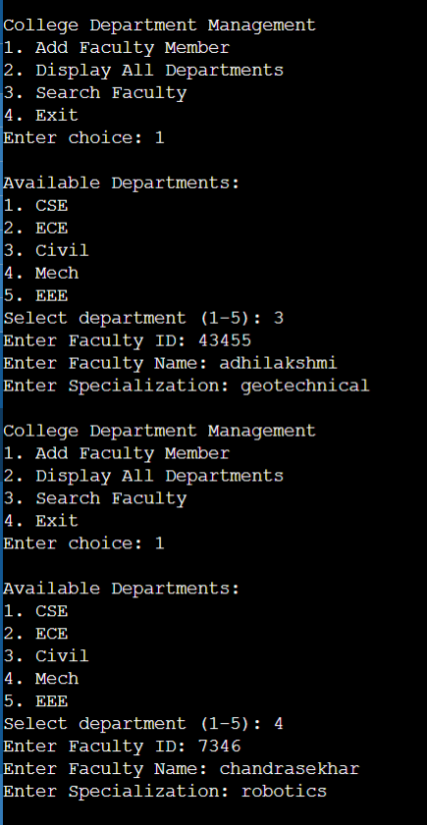
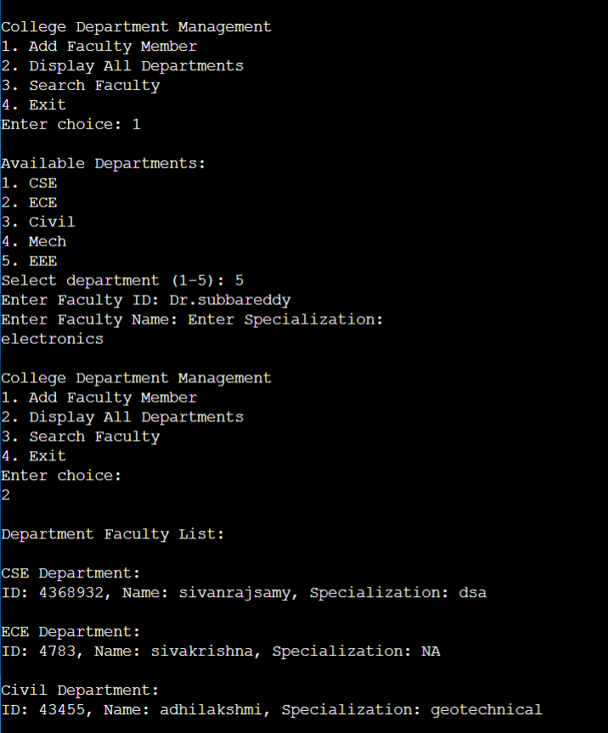
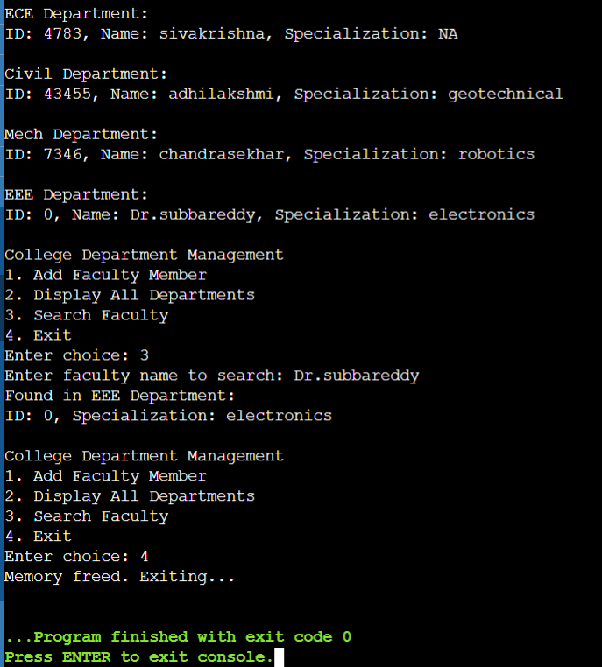

Slide 12
Advantages:
Simple and Understandable Design
Combines basic data structures (array and linked list) for clarity and ease of implementation.
Array indexing allows constant-time access to departments.
Dynamic Faculty Management:
Linked lists allow flexible and dynamic addition of faculty members without predefined limits.
Memory Efficient for Faculty List:
Memory is allocated only when a new faculty is added, avoiding wastage.
Limitations:
Fixed Number of Departments
No Deletion or Update Functionality
Linear Search for Faculty Not Included
Lack of Input Validation
No File Storage or Persistence

Slide 13
CONCLUSION:
The system effectively demonstrates how to manage departments and faculty using arrays and linked lists.
It provides a clear example of integrating static and dynamic data structures in C programming.

Slide 14
THANK YOU

